Slide 1
Introduction to Data Analysis
Ben Arnold, PhD
Associate Professor
F.I. Proctor foundation, UCSF
October 21, 2021
Ben.arnold@ucsf.edu

Slide 2
Much of today’s material was developed with Dr. Catie Oldenburg, Proctor Foundation

Slide 3
These slides along with R code and underlying data are publicly available here:
https://github.com/proctor-ucsf/ophtho-teaching-data-analysis

Slide 4
Common Goals of Data Analysis
Exploration and discovery
Answering scientific questions (often testing hypotheses!)
Prediction (not a focus today)
Across these goals, we seek to learn new things by aggregating individual observations into summaries — either through visualization (graphs) or statistics

Slide 5
Data: the raw material for analysis Datasets contain variables These are common variable types:
Quantitative: Best Spectacle-Corrected Visual Acuity (BSCVA)
Categorical: Treatment success / failure (2 groups = special case: “dichotomous” or “binary”)
Counts: Number of deaths in a community
Time to event: Time from treatment to recovery
Each type of variable implies a different type of analysis

Slide 6
A bit of general advice
If you don’t know where the data came from, you need to find out the details.
How were the data generated?
Were data from different sources joined (merged)? If so, how?
How were variables measured?
How were variables created?
No matter how sophisticated the analysis, you can’t learn very much from bad data
If you dive into a data analysis without exploring the data through description, you’re almost certain to miss important details.

Slide 7

R is a language for statistical computing RStudio is an interface for R

Slide 8

Contact me if you’re interested in learning R through DataCamp

Slide 9

No, seriously

Slide 10
Exploration & Discovery

Slide 11
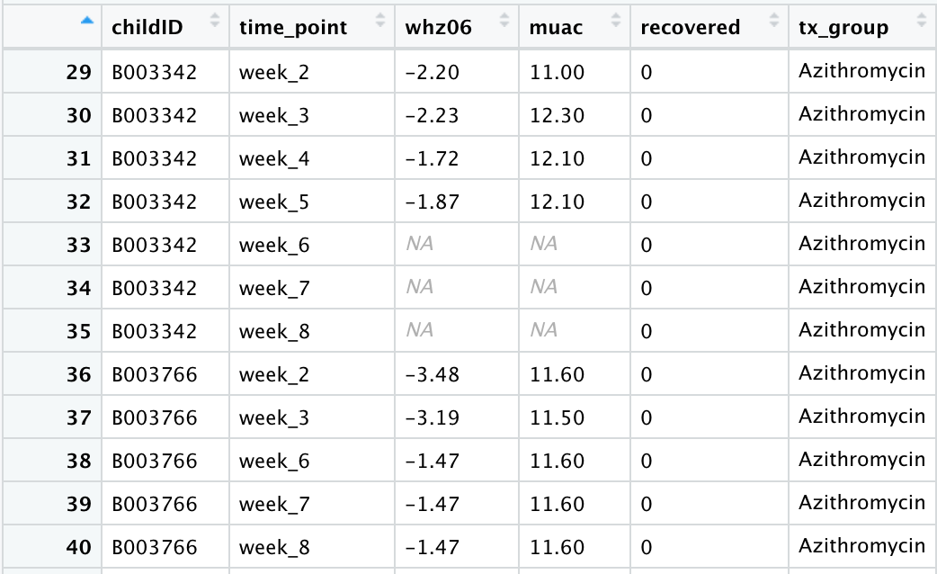
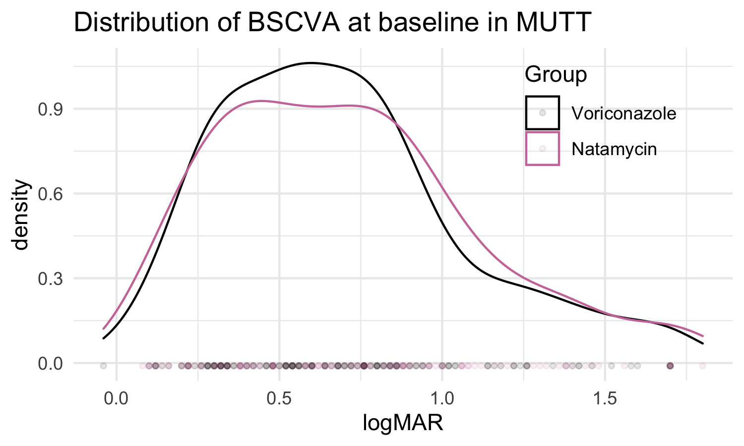
Look at your data
?
“Scrolling” through a dataset is valuable — you won’t learn much scientifically, but you might catch errors and find the unexpected
View(data)
Examine how variables are distributed with frequency histograms and smoothed density distributions, especially for quantitative variables
ggplot(data, aes(x=logmar) + geom_density()
Prajna et al. JAMA Ophthalmol. 2013;131(4):422-429.

Slide 12
Descriptive Statistics
Describe the population under study
Age distribution, gender balance, etc
Usually Table 1 in a manuscript
Quantitative variables
Medians and interquartile ranges (good if there are heavy tails or outliers)
Means and standard deviations
Categorical/dichotomous variables
Proportions
Binomial confidence intervals (e.g., for prevalence estimates)

Slide 13
Answering Scientific Questions

Slide 14
All studies begin with a good research question
There are lots of great questions, but those that lead to great studies draw on scientific/clinical knowledge (novelty, relevance) and respect constraints (budget, time, ethics)

Slide 15
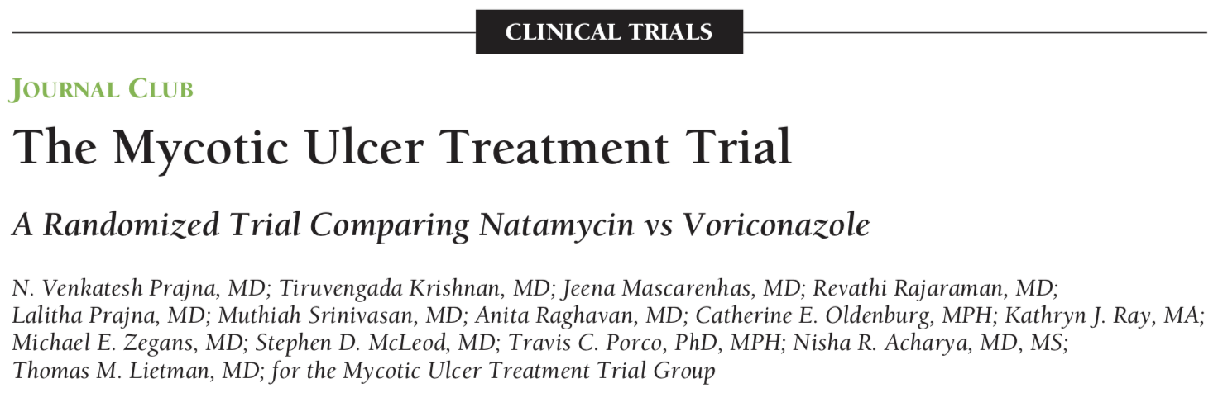
Example: MUTT
Prajna et al. JAMA Ophthalmol. 2013;131(4):422-429.

Slide 16
Example: MUTT
Among patients with smear-positive filamentous fungal keratitis, does topical natamycin improve visual acuity more than voriconazole after 3 months?
P Population (patients) | Patients with a smear-positive fungal corneal ulcer and baseline visual acuity of 20/40 to 20/400
I Intervention (or exposure) | natamycin
C Comparison group | voriconazole
O Outcome of interest | best spectacle-corrected visual acuity
T Time | 3 months from enrollment
Prajna et al. JAMA Ophthalmol. 2013;131(4):422-429.

Slide 17
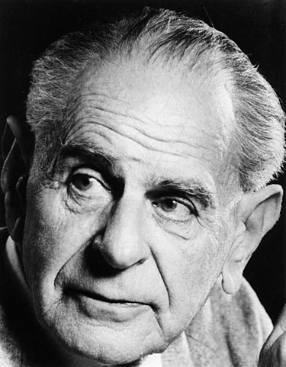
A dominant paradigm in science and analysis: the null hypothesis
Karl Popper (1902-1994)
The Falsification Principle, proposed by Karl Popper, is a way of demarcating science from non-science.
Popper: for a theory to be considered scientific it must be able to be tested and conceivably proven false.
This paradigm underpins the idea of Null Hypothesis testing
https://en.wikipedia.org/wiki/Karl_Popper#/media/File:Karl_Popper.jpg
https://www.simplypsychology.org/Karl-Popper.html

Slide 18
Null hypothesis in MUTT
H₀ – null hypothesis
BSCVA among patients who receive natamycin (intervention) is the same as among patients who receive voriconazole (standard of care)
H_{A} – alternative hypothesis
BSCVA among patients who receive natamycin is better (lower logMAR) than patients who receive voriconazole
even more conservative:
is worse or better
(i.e., different in either direction)

Slide 19
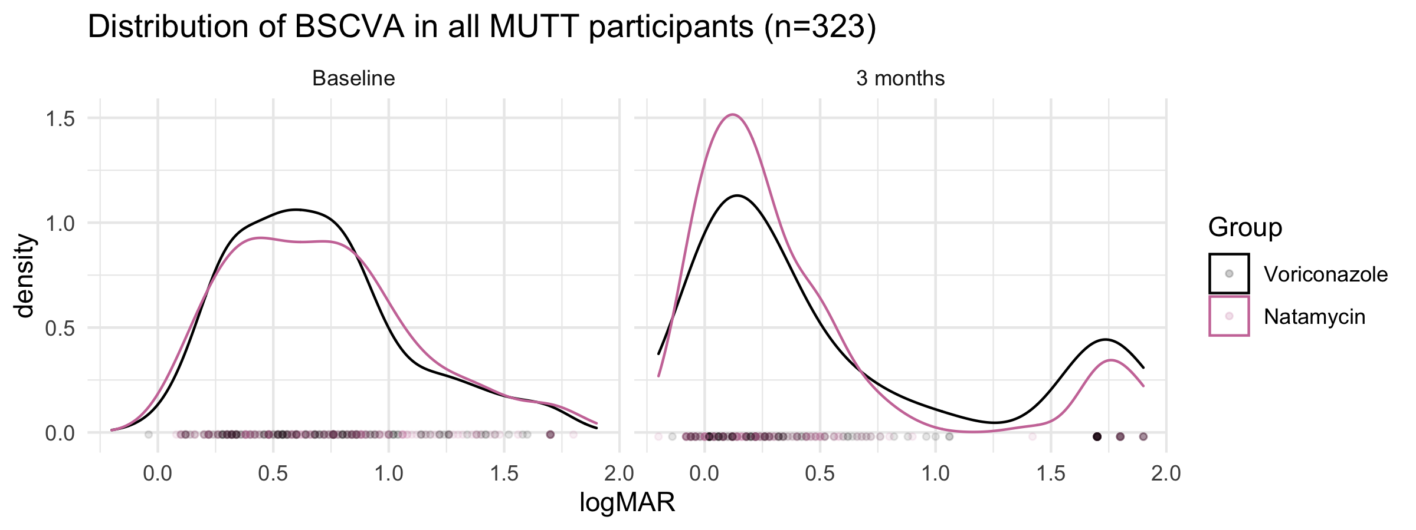
BSCVA in MUTT: are groups different at 3 months?

Slide 20
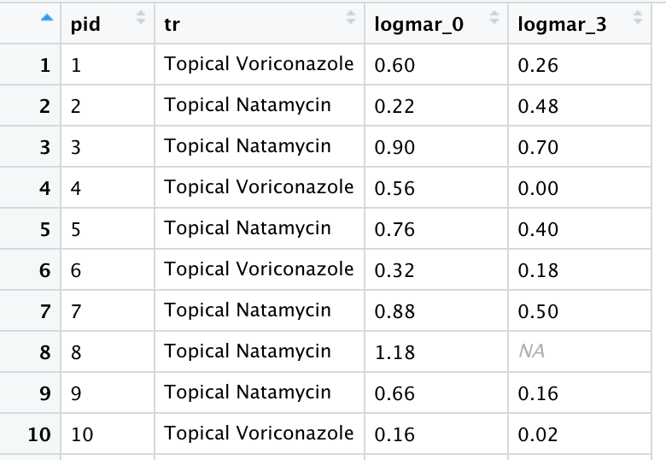
BSCVA is a quantitative outcome
Some options for statistical testing:
T-test for the difference in means
Assumes that the values are approximately normally distributed (like a bell curve) and independent
t.test()
Wilcoxon rank sum test for difference in ranks (also called the Mann-Whitney-U test)
Like the t-test, it assumes values are independent but makes no assumption about the distribution of values — if a variable is very skewed or has a distribution that is nothing like a bell curve then consider this!
wilcox.test()
MUTT BSCVA measures at baseline and 3 months
.
.
.

Slide 21
Statistical tests for difference at 3 months
T-test
t.test(logmar_3 ~ tr, data=d)
t = -2.2004, df = 281.36, p-value = 0.02859
Wilcoxon rank sum test:
wilcox.test(logmar_3 ~ tr, data=d)
W = 11825, p-value = 0.1056
Some evidence for a difference
Notes:
Non-parametric tests make fewer assumptions, and sometimes they have lower power. In this example, the assumption that BSCVA is approximately normal at 3 months is probably OK although there were a few outliers who lost their vision.

Slide 22
P-values
A p-value is the probability of observing a test statistic, such as a T-statistic in a t-test, as big or bigger than that observed if the null hypothesis were true.
Assumes:
Null hypothesis is correct
There is no source of bias in the process of data collection or analysis

Slide 23
Many biostatisticians do not like P-values
Major criticisms are:
They promote binary thinking (”significant” vs. “not-significant”)
They tell you nothing about the magnitude of effect, which we care about in clinical medicine!
“In cynical moments, I find myself discarding a p-value as little more than an alternate measure of sample size, since all null hypotheses will produce small p-values so long as enough data are collected”
- Nick Jewell, UC Berkeley (Statistics for Epidemiology (2004), p 61)

Slide 24
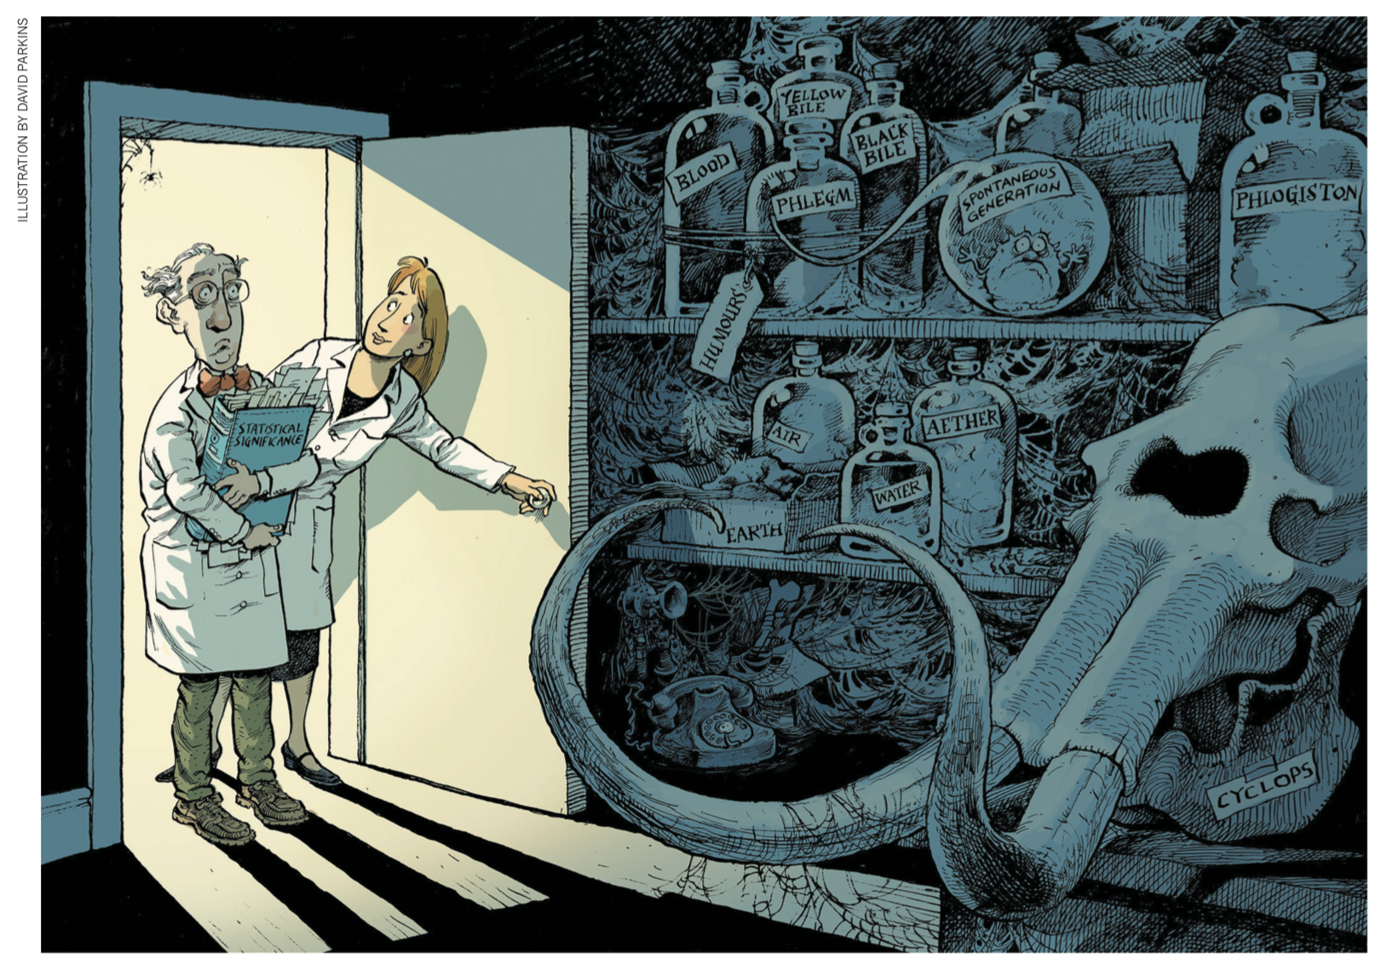
Amrhein, V., Greenland, S. & McShane, B.
Scientists rise up against statistical significance. Nature 567, 305–307 (2019). https://pubmed.ncbi.nlm.nih.gov/30894741/

Slide 25
Instead, we usually prefer measures of effect such as a difference between groups and a measure of uncertainty (95% confidence interval)
In the MUTT trial, the mean logMAR at 3 months was:
Our null hypothesis was that the difference would be zero.
Is –0.16 different from zero by chance?
Group | Mean logMAR at 3 months | Difference
Voriconazole | 0.563
Natamycin | 0.407 | –0.16

Slide 26
95% confidence intervals A measure of uncertainty in our estimate
Construction of a 95% Confidence Interval:
Mean difference ± 1.96 x SE
Theoretical interpretation of a 95% Confidence Interval:
If we were to repeat the identical study 1000 times, the confidence interval in 95% of the repeated studies (~950) will contain the true mean difference.
Pragmatic use of a 95% Confidence Interval vis-à-vis hypothesis testing:
If our null hypothesis is that the difference is zero and the 95% CI for the difference excludes zero, then we can reject the null hypothesis at alpha-level 0.05.
alpha
level (0.05)
Standard Error of the mean difference
(a function of outcome variability and sample size)

Slide 27
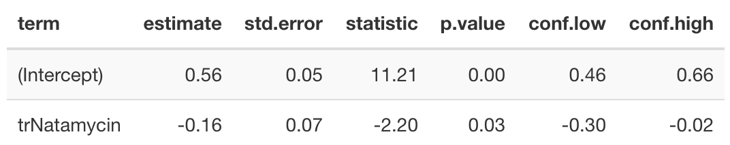
Linear Regression
For a quantitative outcome and binary exposure (Treatment / control), you can estimate the mean difference, SE, and 95% CI very easily with a linear regression.
fit <- lm(logmar_3 ~ tr, data=d)
kable(tidy(fit, conf.int = TRUE), digits = 2)
So the 95% CI is (–0.30, –0.02)
Mean in Voriconazole
Natamycin – Voriconazole

Slide 28
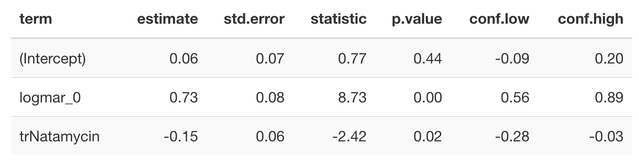
Linear Regression – adjusting for covariates
With quantitative outcomes, if a baseline value is highly correlated with the outcome then you can sometimes gain a bit of precision (smaller SE, narrower 95% CI) by adjusting for baseline. Regression makes this easy.
fit2 <- lm(logmar_3 ~ logmar_0 + tr, data=d)
kable(tidy(fit, conf.int = TRUE), digits = 2)
Natamycin – Voriconazole
Compare to Table 5 in Prajna et al. JAMA Ophthalmol. 2013;131(4):422-429.

Slide 29
Analysis of dichotomous outcomes

Slide 30
Epidemiologic measures of disease Prevalence, Incidence Rate, Risk
Prevalence: the proportion of the population with a disease at a certain point in time
Cases observed / people measured
Unitless
Incidence rate: the rate of new (or newly diagnosed) cases of disease per unit of time
New cases / person-year
Units are person-time
Risk: is the proportion of a population who experienced the outcome over a defined period of time
New cases during the period / people at risk at the beginning of the period
Unitless: time is implied, but not explicit

Slide 31
2x2 Table: Dichotomous Outcomes
 | Outcome | Outcome
Exposure | Yes | No | Total
Yes | a | b | a + b
No | c | d | c + d
Total | a + c | b + d | N

Slide 32
2x2 Table: Risk
“Probability that an event will occur”
 | Outcome | Outcome
Exposure | Yes | No | Total
Yes | a | b | a + b
No | c | d | c + d
Total | a + c | b + d | N
Risk in exposed = a/(a+b)
Risk in unexposed = c/(c+d)

Slide 33
2x2 Table: Risk Ratios
 | Outcome | Outcome
Exposure | Yes | No | Total
Yes | a | b | a + b
No | c | d | c + d
Total | a + c | b + d | N
Risk Ratio = Risk in Exposed/Risk in Unexposed = [a/(a+b)]/[c/(c+d)]

Slide 34
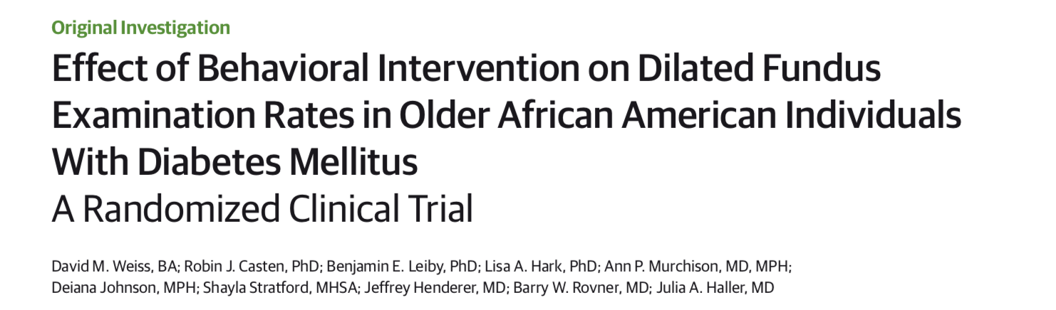
Weiss et al, JAMA Ophthalmol. 2015;133(9):1005-1012.

Slide 35
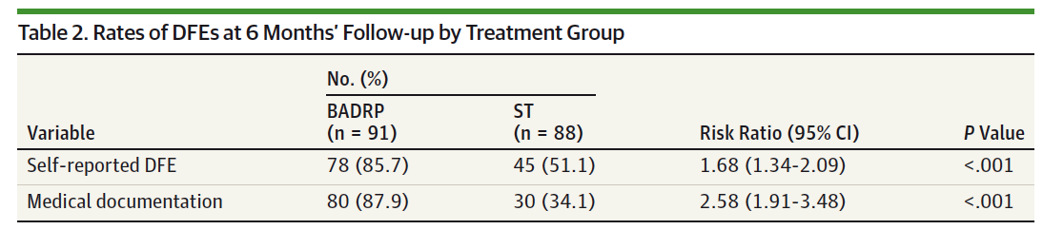
Calculating Risk Ratios
Risk of Dilated Fundus Examination (DFE) by 6 months
Weiss et al, JAMA Ophthalmol. 2015;133(9):1005-1012.
Notes:
Data from an RCT of a behavioral intervention for improving rates of dilated fundus exam among AA adults with diabetes

Slide 36
Calculating Risk Ratios
 | DFE | No DFE
BADRP | Yes | No | Total
Yes | 80 | 11 | 91
No | 30 | 58 | 88
Total | 110 | 69 | 179
Risk Ratio = Risk in Exposed/Risk in Unexposed = [a/(a+b)]/[c/(c+d)]

Slide 37
Calculating Risk Ratios
 | DFE | No DFE
BADRP | Yes | No | Total
Yes | 80 | 11 | 91
No | 30 | 58 | 88
Total | 110 | 69 | 179
RR = [80/(80+11)]/[30/(30+58)] = 2.58

Slide 38
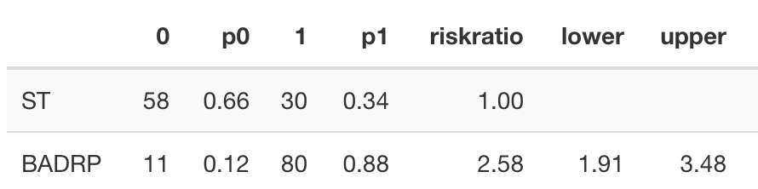
Please, don’t do data analysis by hand if you can avoid it!
library(epitools)
rr_est <- epitab(x=dweiss$tr, y = dweiss$dfe, method = "riskratio")
kable(rr_est$tab, digits = 2)

Slide 39
Interpreting Risk Ratios
Risk of Dilated Fundus Examination (DFE) by 6 months
“Overall, BADRP participants were approximately 2.5 times more likely to obtain a DFE compared with ST participants.”
Weiss et al, JAMA Ophthalmol. 2015;133(9):1005-1012.
Notes:
Data from an RCT of a behavioral intervention for improving rates of dilated fundus exam among AA adults with diabetes

Slide 40
2x2 Table: Odds
 | Outcome | Outcome
Exposure | Yes | No | Total
Yes | a | b | a + b
No | c | d | c + d
Total | a + c | b + d | N
Odds in the Exposed: a/b Odds in the Unexposed: c/d

Slide 41
2x2 Table: Odds Ratios
 | Outcome | Outcome
Exposure | Yes | No | Total
Yes | a | b | a + b
No | c | d | c + d
Total | a + c | b + d | N
Odds Ratio = (a/b)/(c/d)

Slide 42
BADRP Study: Odds Ratio
 | DFE | No DFE
BADRP | Yes | No | Total
Yes | 80 | 11 | 91
No | 30 | 58 | 88
Total | 110 | 69 | 179
Odds Ratio = (a/b)/(c/d)
Notes:
Compare to RR, which was 2.58

Slide 43
BADRP Study: Odds Ratio
 | DFE | No DFE
BADRP | Yes | No | Total
Yes | 80 | 11 | 91
No | 30 | 58 | 88
Total | 110 | 69 | 179
Odds Ratio = (80/11)/(30/58) = 14.06
Notes:
Compare to RR, which was 2.58

Slide 44
Odds Ratios and Risk Ratios
Odds ratios always greater than the relative risk (further away from the null, 1.0), so must be careful with interpretation. ORs are not a likelihood or probability.
Relative risks are easier to interpret
The difference between RR and OR becomes huge with common outcomes!

Slide 45
Why odds ratios?
Odds ratios are naturally estimated in logistic regression, so reporting an OR is convenient
For rare outcomes (e.g., proportion < 0.15) the OR and RR are almost identical

Slide 46
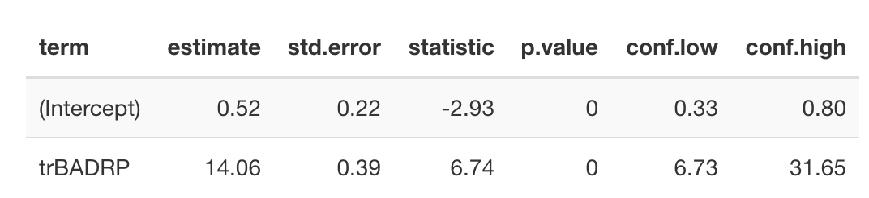
Example from the BADRP study
Logistic regression is implemented through generalized linear models (GLM).
In R, this is glm()
or_fit <- glm(dfe ~ tr, data= dweiss, family = binomial(link = "logit"))
kable(tidy(or_fit,conf.int = TRUE, exponentiate = TRUE), digits = 2)
OR

Slide 47
Estimating RR with regression sometimes requires one extra step (robust SEs)
Barros, A. J. D. & Hirakata, V. N. Alternatives for logistic regression in cross-sectional studies: an empirical comparison of models that directly estimate the prevalence ratio. BMC Med. Res. Methodol. 3, 21 (2003).
McNutt, L.-A., Wu, C., Xue, X. & Hafner, J. P. Estimating the relative risk in cohort studies and clinical trials of common outcomes. Am. J. Epidemiol. 157, 940–943 (2003).
Zou, G. A modified poisson regression approach to prospective studies with binary data. Am. J. Epidemiol. 159, 702–706 (2004).

Slide 48
Absolute versus Relative Risk
Odds and risk ratios describe the relative difference in risk
Can be equally (or more) clinically meaningful to know the absolute difference in risk

Slide 49
Absolute versus Relative Risk
Randomized controlled trial for Drug versus Placebo to prevent rare complication
 | Complication | No Complication
 | Yes | No | Total
Drug | 1 | 119 | 120
Placebo | 2 | 118 | 120
Total | 3 | 237 | 240

Slide 50
Absolute versus Relative Risk
Risk Ratio = 0.50: 50% reduced risk of complication with the drug
 | Complication | No Complication
 | Yes | No | Total
Drug | 1 | 119 | 120
Placebo | 2 | 118 | 120
Total | 3 | 237 | 240

Slide 51
Absolute versus Relative Risk
Absolute Risk: (2/120) – (1/120) = 1.7%– 0.8% = 0.9% absolute difference in risk
Excess risk is <1 per 100 patients
 | Complication | No Complication
 | Yes | No | Total
Drug | 1 | 119 | 120
Placebo | 2 | 118 | 120
Total | 3 | 237 | 240
Notes:
Up to clinical judgement about whether or not this is really meaningful (severity of outcome etc)

Slide 52

Wrapping up

Slide 53
Wrapping up: some additional best practices
For hypothesis testing, pre-specify your hypothesis and document it!
Clinicaltrials.gov
Open Science Framework Registrations (https://osf.io/prereg/)
Time-stamped NIH grant application
Create a participant flow diagram (see CONSORT + STROBE Reporting checklists)
Whenever possible use a reproducible workflow
Programs that read in data, do analyses, create tables + graphs (R, Stata)
Avoid point and click analyses in Excel → they are very error prone!
We have some best practices in our handbook: https://proctor-ucsf.github.io/dcc-handbook/
Consider making your de-identified data and analysis script public alongside your article.

Slide 54
This is a big topic, and we’ve barely scratched the surface. Write me with questions!
ben.arnold@ucsf.edu

